Slide 1
K12 Accelerator Canvas & Model Apps and K12 Portal
Packaging & Layering
Education Accelerator K12 Portal
PowerApps Portal
Education Accelerator K12 Canvas Apps
Education K12 Model Apps
Education Accelerator K12
Education Accelerator Connection Roles
Education Accelerator Common
Microsoft Dataverse
K12 Specific Solutions
Existing Microsoft Business Applications Solutions

Slide 2
Education Accelerator Common -> Primary Entities
Entity Name
Academic Period
Academic Period Detail
Academic Subject
Achievements
Accomplishment
Area of Interest
Area of Study
Bell Schedule
Bell Schedule Time
Certification
Certification Process
Certification Requirement
Education Accelerator K12 Portal
PowerApps Portal
Education Accelerator K12 Canvas Apps
Education K12 Model Apps
Education Accelerator K12
Education Accelerator Connection Roles
Education Accelerator Common
Microsoft Dataverse

Slide 3
Education Accelerator Common -> Primary Entities (continued)
Entity Name
Course
Course History
Course Section
Credential
Education Level
External System
External System Identifier
Extra Curricular Activity
Extra Curricular Participant
Internship
Internship Applicant
Previous Education
Program
Program Level
Education Accelerator K12 Portal
PowerApps Portal
Education Accelerator K12 Canvas Apps
Education K12 Model Apps
Education Accelerator K12
Education Accelerator Connection Roles
Education Accelerator Common
Microsoft Dataverse

Slide 4
Education Accelerator Common -> Primary Entities (continued)
Entity Name
Program Requirement
Program Version
Program Version Detail
Recommended Student Resource
Registration Status
Scholarship
Scholarship Applicant
School Calendar
School Calendar Date
Student Program Type
Student Resource
Student Status
Test Score
Test Type
Education Accelerator K12 Portal
PowerApps Portal
Education Accelerator K12 Canvas Apps
Education K12 Model Apps
Education Accelerator K12
Education Accelerator Connection Roles
Education Accelerator Common
Microsoft Dataverse

Slide 5
Education Accelerator Common -> Enriched Entities
Entity Name | Source
Account | CDM Common
Address | CDM Common
Appointment | CDM Common
Connection | CDM Common
Contact | CDM Common
Task | CDM Common
User | CDM Common
Education Accelerator K12 Portal
PowerApps Portal
Education Accelerator K12 Canvas Apps
Education K12 Model Apps
Education Accelerator K12
Education Accelerator Connection Roles
Education Accelerator Common
Microsoft Dataverse

Slide 6
Education Accelerator Connection Roles -> Primary Connection Roles
Connection Roles
Adjunct
Administrator
Advisor
Affiliate
Aide
Alumni
Assistant
Chair
Coach
Doctor
Faculty
Guardian
Instructor
IT Admin
Education Accelerator K12 Portal
PowerApps Portal
Education Accelerator K12 Canvas Apps
Education K12 Model Apps
Education Accelerator K12
Education Accelerator Connection Roles
Education Accelerator Common
Microsoft Dataverse

Slide 7
Education Accelerator Connection Roles -> Primary Connection Roles
Connection Roles
Lecturer
Nurse
Occupational Therapist
Office Staff
Other
Paraprofessional
Parent
Physical Therapist
Principal
Proctor
Professor
Relative
Researcher
Special Services
Education Accelerator K12 Portal
PowerApps Portal
Education Accelerator K12 Canvas Apps
Education K12 Model Apps
Education Accelerator K12
Education Accelerator Connection Roles
Education Accelerator Common
Microsoft Dataverse

Slide 8
Education Accelerator Connection Roles -> Primary Connection Roles
Connection Roles
Speech
Staff
Student
Substitute
Teacher
Teacher Assistant
Vision
Education Accelerator K12 Portal
PowerApps Portal
Education Accelerator K12 Canvas Apps
Education K12 Model Apps
Education Accelerator K12
Education Accelerator Connection Roles
Education Accelerator Common
Microsoft Dataverse

Slide 9
Education Accelerator K12 -> Primary Entities
Entity Name
Assessment
Assessment Delivery
Assessment Item
Assessment Score
Attendance
Behavior Incident
Education Content
Grading Period
Incident Action
Incident Type
Intervention
Intervention Participant
Education Accelerator K12 Portal
PowerApps Portal
Education Accelerator K12 Canvas Apps
Education K12 Model Apps
Education Accelerator K12
Education Accelerator Connection Roles
Education Accelerator Common
Microsoft Dataverse

Slide 10
Education Accelerator K12 -> Primary Entities (continued)
Education Accelerator K12 Portal
Entity Name
Learned Standard
Learning Standard Criteria
Student Assessment Item Response
PowerApps Portal
Education Accelerator K12 Canvas Apps
Education K12 Model Apps
Education Accelerator K12
Education Accelerator Connection Roles
Education Accelerator Common
Microsoft Dataverse

Slide 11
Education Accelerator K12 -> Enriched Entities
Entity Name | Source
Academic Period | Education Accelerator Common
Academic Period Detail | Education Accelerator Common
Accomplishment | Education Accelerator Common
Activity | CDM Common
Appointment | CDM Common
Area of Interest | Education Accelerator Common
Area of Study | Education Accelerator Common
Bell Schedule | Education Accelerator Common
Contact | CDM Common
Course | Education Accelerator Common
Course History | Education Accelerator Common
Course Section | Education Accelerator Common
Extra Curricular Activity | Education Accelerator Common
Extra Curricular Participant | Education Accelerator Common
Education Accelerator K12 Portal
PowerApps Portal
Education Accelerator K12 Canvas Apps
Education K12 Model Apps
Education Accelerator K12
Education Accelerator Connection Roles
Education Accelerator Common
Microsoft Dataverse

Slide 12
Education Accelerator K12 -> Enriched Entities (continued)
Entity Name | Source
Internship | Education Accelerator Common
Internship Applicant | Education Accelerator Common
Letter | Common CDM
Previous Education | Education Accelerator Common
Process Session | Common CDM
Program | Education Accelerator Common
Program Level | Education Accelerator Common
Registration Status | Education Accelerator Common
School Calendar | Education Accelerator Common
Scholarship | Education Accelerator Common
Scholarship Applicant | Education Accelerator Common
Sync Error | Common CDM
Task | Common CDM
Test Score | Education Accelerator Common
Test Type | Education Accelerator Common
Education Accelerator K12 Portal
PowerApps Portal
Education Accelerator K12 Canvas Apps
Education K12 Model Apps
Education Accelerator K12
Education Accelerator Connection Roles
Education Accelerator Common
Microsoft Dataverse

Slide 13
Education K12 Model Apps -> Apps
Education Accelerator K12 Portal
App Name | Type
K12 Education | Model-Driven
PowerApps Portal
Education Accelerator K12 Canvas Apps
Education K12 Model Apps
Education Accelerator K12
Education Accelerator Connection Roles
Education Accelerator Common
Microsoft Dataverse

Slide 14
Education Accelerator K12 Canvas Apps -> Apps
App Name | Type
K12 Attendance App | Canvas
K12 Behavior Management | Canvas
K12 Attendance App - Mobile | Canvas
Education Accelerator K12 Portal
PowerApps Portal
Education K12 Model Apps
Education Accelerator K12 Canvas Apps
Education Accelerator K12
Education Accelerator Connection Roles
Education Accelerator Common
Microsoft Dataverse

Slide 15
Education Accelerator K12 Portal -> Enriched Entities
Entity Name | Source
Academic Period Detail | Education Accelerator Common
Account | Common CDM
Achievement | Education Accelerator Common
Activity | Common CDM
Assessment | Education Accelerator K12
Assessment Delivery | Education Accelerator K12
Assessment Score | Education Accelerator K12
Attendance | Education Accelerator K12
Behavior Incident | Education Accelerator K12
Contact | Common CDM
Course Section | Education Accelerator Common
Education Content | Education Accelerator K12
Extra Curricular Activity | Education Accelerator Common
Extra Curricular Participant | Education Accelerator Common
Education Accelerator K12 Portal
PowerApps Portal
Education K12 Model Apps
Education Accelerator K12 Canvas Apps
Education Accelerator K12
Education Accelerator Connection Roles
Education Accelerator Common
Microsoft Dataverse

Slide 16
Education Accelerator K12 Portal -> Enriched Entities (continued)
Entity Name | Source
Intervention | Education Accelerator K12
Intervention Participant | Education Accelerator K12
Learning Standard | Education Accelerator K12
Letter | Common CDM
School Calendar Date | Education Accelerator Common
Task | Common CDM
Test Score | Education Accelerator Common
Education Accelerator K12 Portal
PowerApps Portal
Education K12 Model Apps
Education Accelerator K12 Canvas Apps
Education Accelerator K12
Education Accelerator Connection Roles
Education Accelerator Common
Microsoft Dataverse

Slide 17
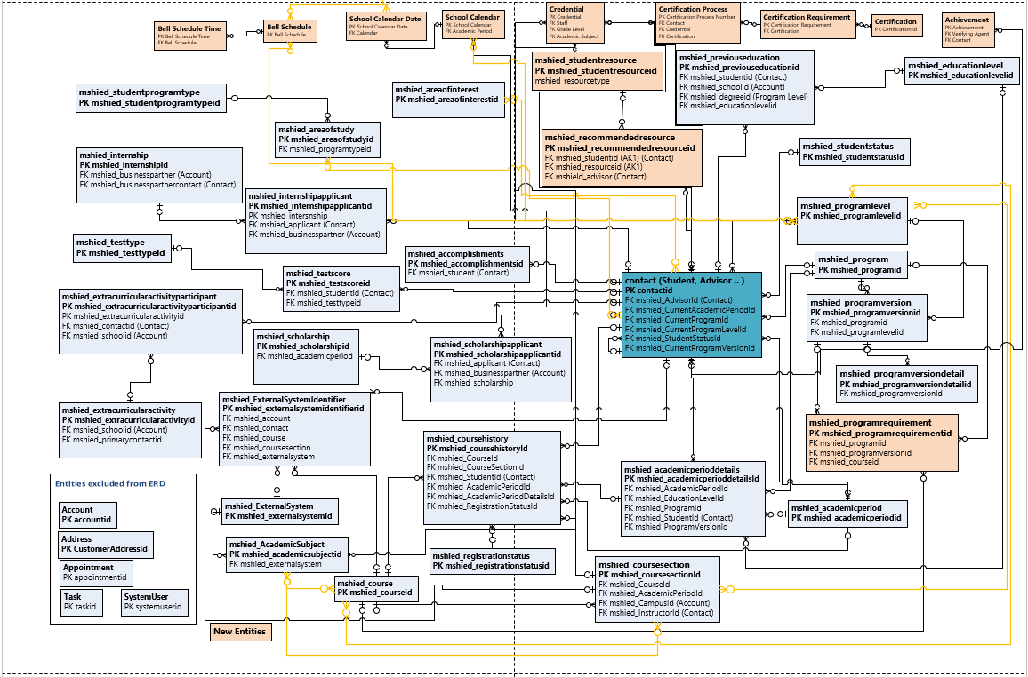
ERD : Education Accelerator Common

Slide 18
ERD – K12 Education: K12 Accelerator

Slide 19
Connection Roles From Account to Contact
Adjunct
Administrator
Advisor
Affiliate
Aide
Alumni
Assistant
Chair
Coach
Doctor
Faculty
Guardian
Instructor
IT Admin
Lecturer
Nurse
Occupational Therapist
Office Staff
Other
Paraprofessional
Parent
Physical Therapist
Principal
Proctor
Professor
Relative
Researcher
Special services
Speech
Staff
Student
Substitute
Teacher
Teacher Assistant
Vision
Connection Roles From Course and Course History to Contact
Adjunct
Administrator
Advisor
Affiliate
Aide
Assistant
Course
Coach
Instructor
Lecturer
Occupational Therapist
Paraprofessional
Physical Therapist
Principal
Proctor
Professor
Special services
Speech
Student
Substitute
Teacher
Teacher Assistant
Connection Roles
Connection Roles From Contact to Contact
Administrator
Advisor
Aide
Child
Doctor
Guardian
Other
Parent
Relative

